Slide 1
The scene. You are in the army and are part of the minesweeping core who control robots to help them find mines. You are currently in the in the desert and have been given the task of clear a path through a minefield. This is of major importance and you need to send a group of special forces through the field in order to carry out a top secret mission.

Slide 2
The task
You will need to design a route through the terrain of a
desert in order to get your men through. But to do this you
need to design a course on paper first. The base of the
desert will be large squared paper. You then need to draw
and label any obstructions that may lie in the way (it is up
to you to decide where these may be).
After you have done this you will need to trace out a path
which misses the obstacles and will also keep your men
safe. This is the path which the robot will check so it is of
major importance that your men will not be killed by mines
when they follow your route.

Slide 3
The Terrain
You will need to be aware of the following
obstacles and the possible ways of transforming
round them. (There may be others…).

Slide 4
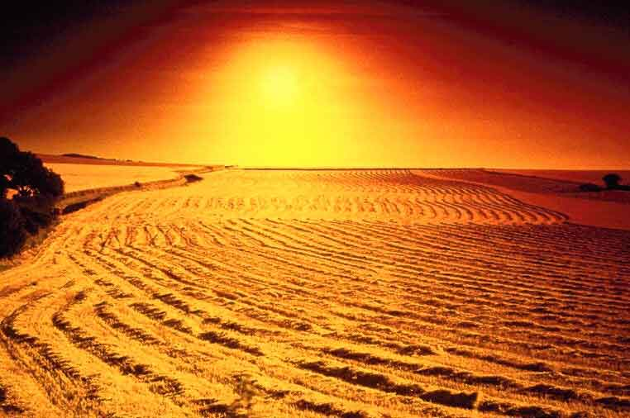
Open desert
How could we describe moving in a straight line over open
land. You will need to be able to give direction as well as
length. Which way is north?

Slide 5
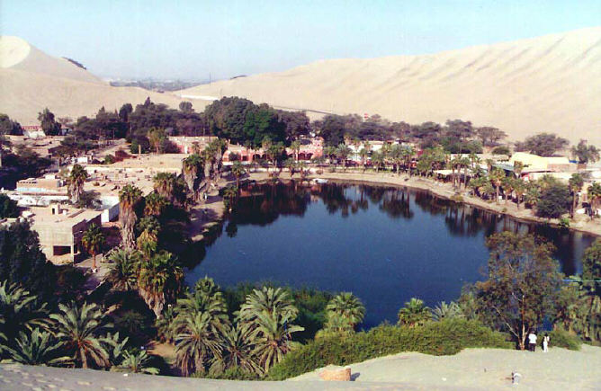
An Oasis
In order to get round an oasis you will need to use Rotation. What will you need to be able to describe how we Rotate our Robot around the Oasis.

Slide 6
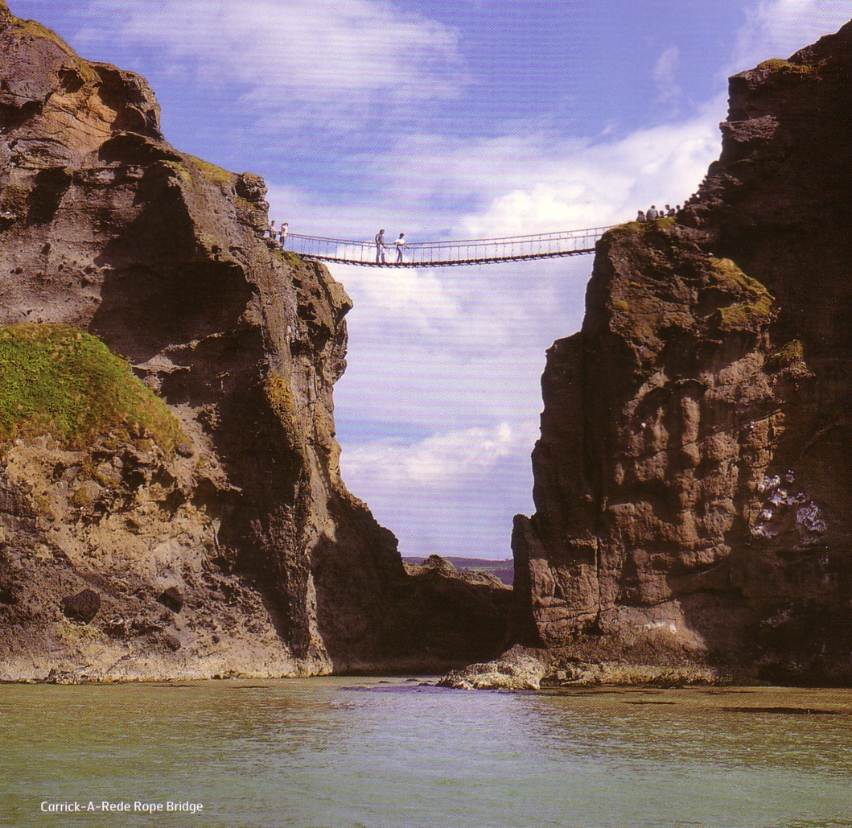
A Desert river
You must use your imagination here. How might you be able to ‘jump’ over this? (There is no bridge) Be careful not to jump too far or not far enough. Your robot must be delivered safe to the other side without touching the Chasm at any point

Slide 7
You will need to assign the following three positions
Commander – Leader of the group, oversees the operation
Drawer in chief – Artist who details the map which shows where the mines, obstacles and terrain.
Movement Chief – Details the precise movement of robot by giving the required transformations

Slide 8
Good Luck

Slide 9
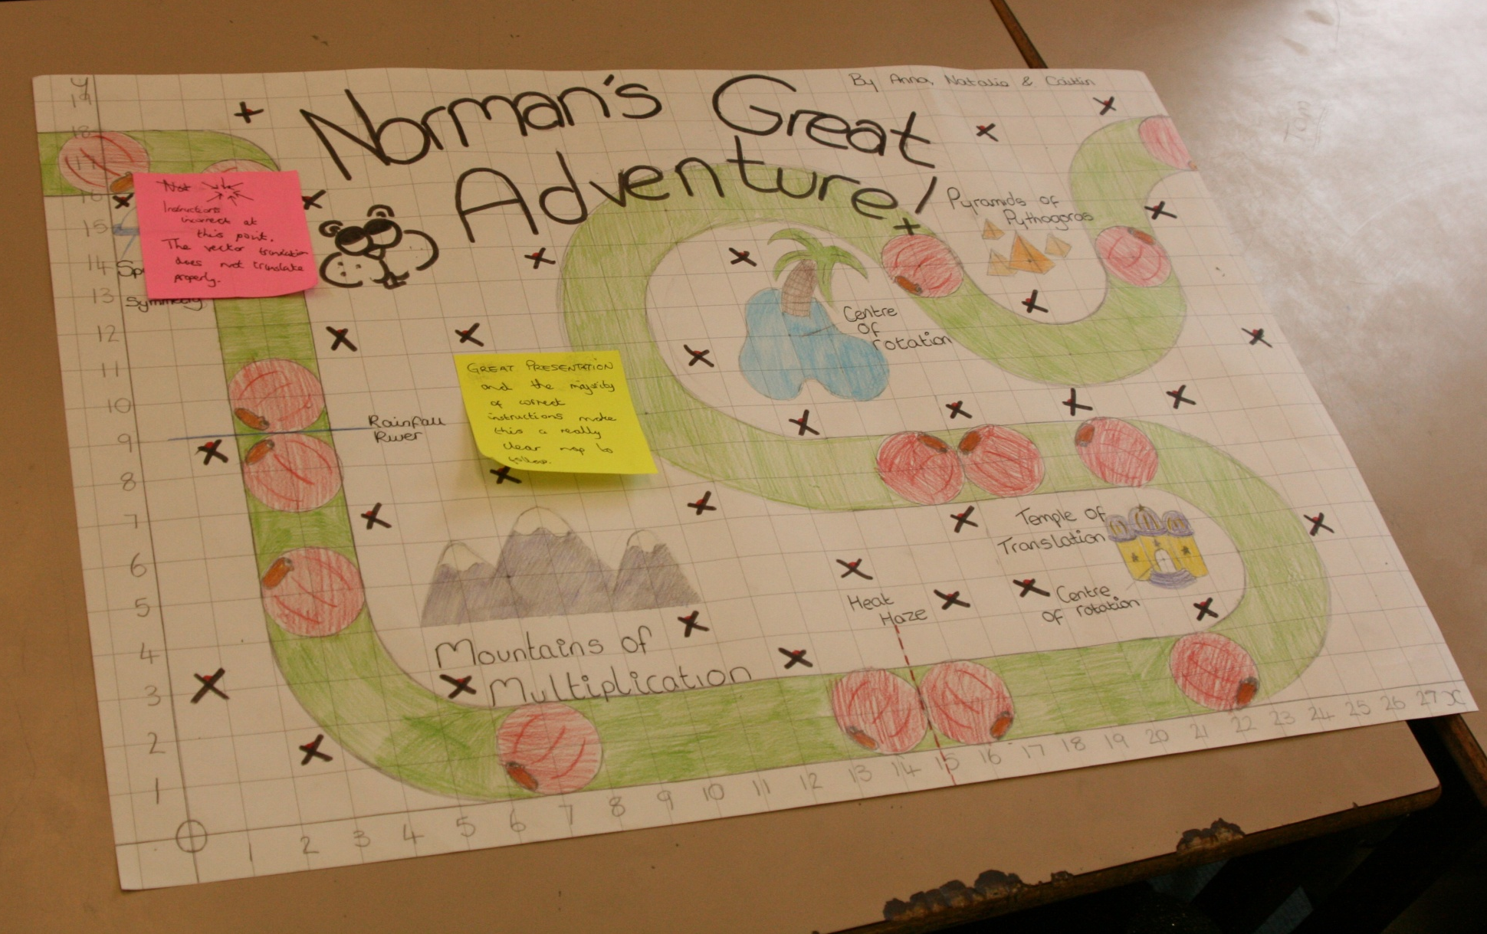
Minesweeper Pupil’s Work

Slide 10
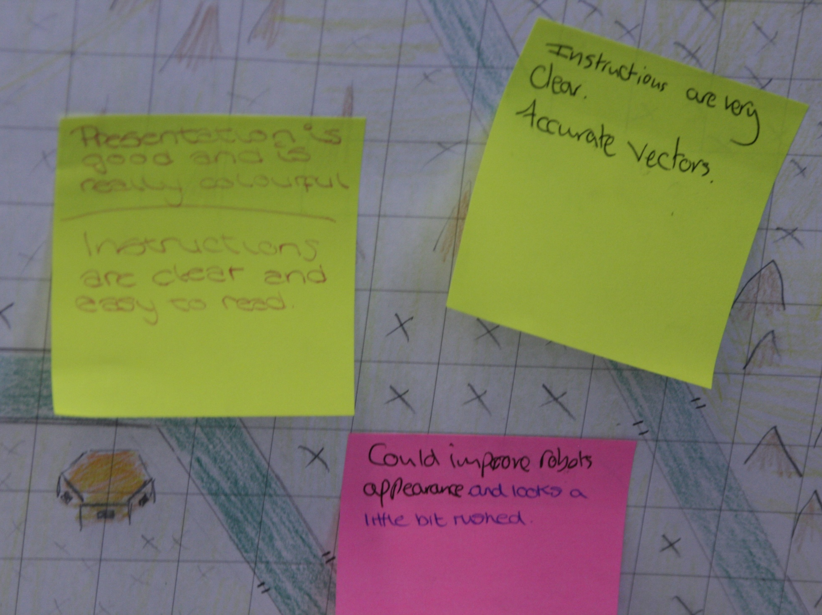

Slide 11
